Slide 1
Python Collection Data Types

Slide 2
Understand different complex (collection) data types of Python.
Difference between different complex data types of Python

Slide 3
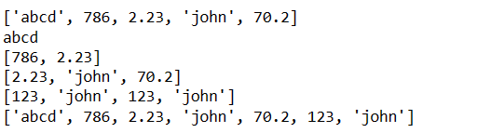
Complex Data Types in Python - List
List is an ordered collection of elements and those elements can be of any data type.
In list, index starts with 0.
List can have duplicate elements.
List can be modified (Mutable).
Lists are defined by enclosing a comma-separated sequence of items within square brackets [].
list = [ 'abcd', 786 , 2.23, 'john', 70.2 ]
tinylist = [123, 'john']
print (list) # Prints complete list
print (list[0]) # Prints first element of the list
print (list[1:3]) # Prints elements starting from 2nd till 3rd
print (list[2:]) # Prints elements starting from 3rd element
print (tinylist * 2) # Prints list two times
print (list + tinylist) # Prints concatenated lists

Slide 4
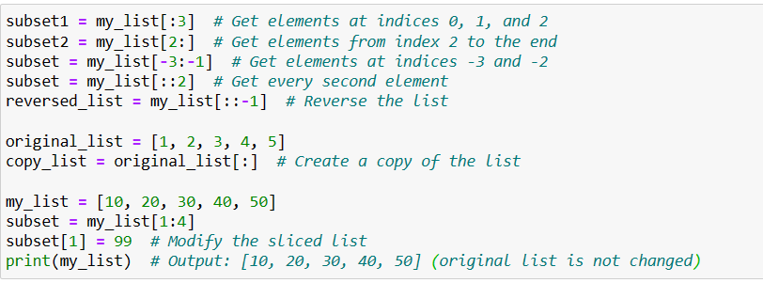
Complex Data Types in Python - List
Accessing list elements
my_list = [10, 20, 30, 40, 50]
print(my_list[0]) # Output: 10
print(my_list[2]) # Output: 30
You can also use negative indexing to access elements from the end of the list:
print(my_list[-1]) # Output: 50 (last element)
print(my_list[-2]) # Output: 40 (second to last element)
List elements are mutable (modifiable).
my_list[2] = 99
print(my_list) # Output: [10, 20, 99, 40, 50]
List Slicing
You can extract a sublist (slice) from a list by specifying a range of indices:
my_list = [10, 20, 30, 40, 50]
subset = my_list[1:4] # Get elements at indices 1, 2, and 3
print(subset) # Output: [20, 30, 40]

Slide 5
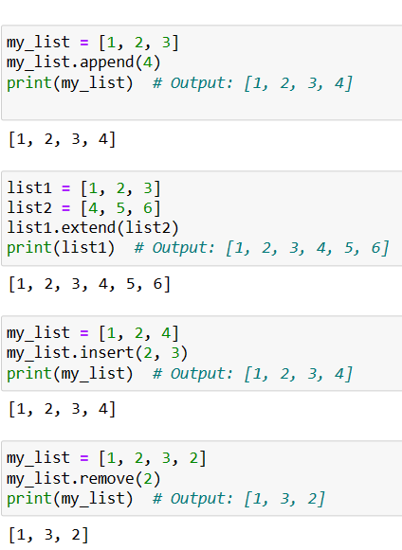
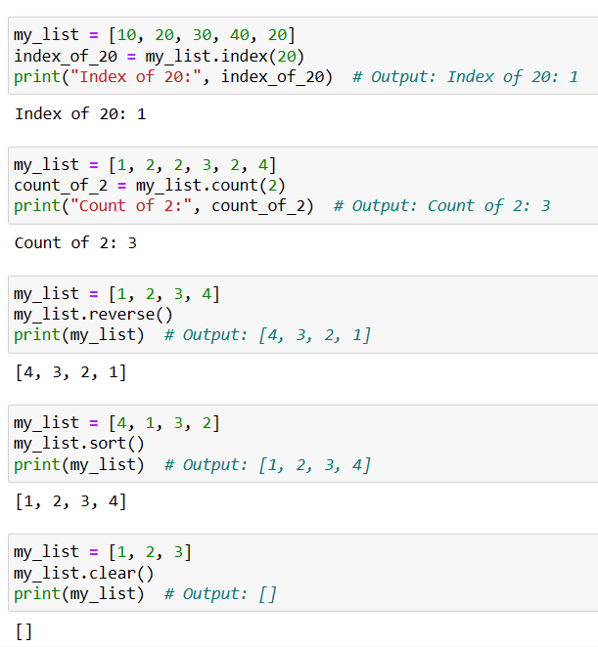
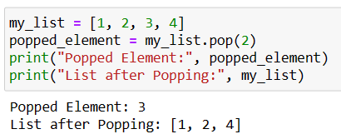
Complex Data Types in Python - List
List Methods:
append(): Add an element to the end of the list.
insert(): Insert an element at a specified index.
remove(): Remove the first occurrence of a specified value.
pop(): Remove and return an element at a specified index.
extend(): Extend a list by appending elements from another iterable.
sort(): Sort the elements of the list in ascending or descending order.
reverse(): Reverse the order of elements in the list.

Slide 6
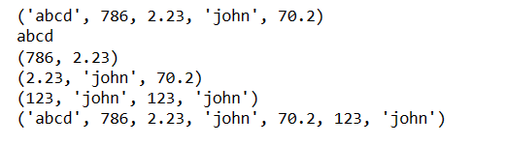
Complex Data Types in Python - Tuple
Tuple is an ordered collection of elements and those elements can be of any data type.
In tuple, index starts with 0.
Tuple can have duplicate elements.
Tuple cannot be modified (Immutable). This immutability makes tuples useful for situations where you want to ensure that the data remains constant.
Tuples are defined by enclosing a comma-separated sequence of items within Parenthesis ().
tuple = ( 'abcd', 786 , 2.23, 'john', 70.2 )
tinytuple = (123, 'john')
print (tuple) # Prints complete list
print (tuple[0]) # Prints first element of the list
print (tuple[1:3]) # Prints elements starting from 2nd till 3rd
print (tuple[2:]) # Prints elements starting from 3rd element
print (tinytuple * 2) # Prints list two times
print (tuple + tinytuple) # Prints concatenated lists

Slide 7
Complex Data Types in Python - Tuple
Following is invalid with tuple, because we attempted to update a tuple, which is not allowed. Similar case is possible with lists:
tuple = ( 'abcd', 786 , 2.23, 'john', 70.2 )
list = [ 'abcd', 786 , 2.23, 'john', 70.2 ]
tuple[2] = 1000 # Invalid syntax with tuple
list[2] = 1000 # Valid syntax with list
Tuple Packing and Unpacking: Tuples can be used for "tuple packing" and "tuple unpacking." Tuple packing is when you group multiple values into a single tuple, and tuple unpacking is when you assign the elements of a tuple to individual variables.
# Tuple packing
point = (3, 4)
# Tuple unpacking
x, y = point
print("x:", x) # Output: x: 3
print("y:", y) # Output: y: 4

Slide 8
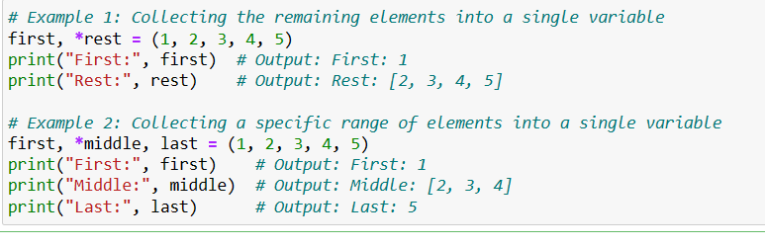
Complex Data Types in Python - Tuple
How can we change Tuple value?
Once a tuple is created, you cannot change its values. Tuples are unchangeable, or immutable as it also is called.
But there is a workaround. You can convert the tuple into a list, change the list, and convert the list back into a tuple.
Example
x = ("apple", "cherry", "grapes")
print(“Before updating :”,x)
y = list(x)
y[1] = "kiwi"
x = tuple(y)
print(“After updating :” , x)
Using Asterisk*
If the number of variables is less than the number of
values, you can add an * to the variable name and
the values will be assigned to the variable as a list:
Tuple Methods:
Tuples have a few built-in methods, but they are limited compared to lists due
to their immutability. Some common methods include count() and index().

Slide 9
Complex Data Types in Python - Set
In Python, a set is an unordered and mutable collection of unique elements.
Sets are similar to lists and tuples in that they can store multiple items, but they differ in that sets do not allow duplicate values.
Sets are defined by enclosing a comma-separated sequence of elements within curly braces {} or by using the set() constructor.
Creating a Set:
my_set = {1, 2, 3} or my_set = set([1, 2, 3])
Adding Elements to a Set:
my_set = {1, 2, 3}
my_set.add(4)
my_set.add(2) # This won't add a duplicate
print(my_set) # Output: {1, 2, 3, 4}
Removing Elements from a Set:
my_set = {1, 2, 3, 4}
my_set.remove(3)
my_set.discard(2)
print(my_set) # Output: {1, 4}

Slide 10
Complex Data Types in Python - Set
Set Operations:
set1 = {1, 2, 3, 4}
set2 = {3, 4, 5, 6}
union_set = set1 | set2 # Union: {1, 2, 3, 4, 5, 6}
intersection_set = set1 & set2 # Intersection: {3, 4}
difference_set = set1 - set2 # Difference: {1, 2}
symmetric_difference_set = set1 ^ set2 # Symmetric Difference: {1, 2, 5, 6}
Set Methods: Sets have various built-in methods, including clear(), copy(), pop(), update(), and others, for performing operations on sets.

Slide 11
Complex Data Types in Python - Dictionary
In Python, a dictionary is a built-in data structure used to store collections of key-value pairs.
They are flexible and allow you to access values using their associated keys, rather than numerical indices.
my_dict = {"name": "Alice", "age": 30, "city": "New York"}
empty_dict = dict()
name = my_dict["name"]
age = my_dict["age"]
print("Name:", name) # Output: Name: Alice
print("Age:", age) # Output: Age: 30
city = my_dict.get("city", "Unknown")
print("City:", city) # Output: City: New York
my_dict["age"] = 31 # Update the age
my_dict["job"] = "Engineer" # Add a new key-value pair
del my_dict["city"] # Remove the "city" key and its associated value

Slide 12
Complex Data Types in Python - Dictionary
Iterating Through a Dictionary:
for key in my_dict:
print(key, my_dict[key])
# Output:
name Alice
age 31
job Engineer
# Iterating through keys
for key in my_dict.keys():
print(key)
# Iterating through values
for value in my_dict.values():
print(value)
# Iterating through key-value pairs
for key, value in my_dict.items():
print(key, value)

Slide 13
Complex Data Types in Python - Dictionary
1. clear(): Removes all key-value pairs from the dictionary, making it empty.
my_dict = {"name": "Alice", "age": 30}
my_dict.clear()
print(my_dict) # Output: {}
2. copy(): Returns a shallow copy of the dictionary.
original_dict = {"name": "Alice", "age": 30}
copy_dict = original_dict.copy()
3. get(): Returns the value associated with a specified key. If the key is not found, it returns a default value (or None if not provided).
my_dict = {"name": "Alice", "age": 30}
name = my_dict.get("name")
city = my_dict.get("city", "Unknown") # Providing a default value
4. items(): Returns a view of all key-value pairs in the dictionary.
my_dict = {"name": "Alice", "age": 30}
items = my_dict.items()
# Output: dict_items([('name', 'Alice'), ('age', 30)])

Slide 14
Complex Data Types in Python - Dictionary
5. keys(): Returns a view of all keys in the dictionary.
my_dict = {"name": "Alice", "age": 30}
keys = my_dict.keys()
# Output: dict_keys(['name', 'age'])
6. values(): Returns a view of all values in the dictionary.
my_dict = {"name": "Alice", "age": 30}
values = my_dict.values()
# Output: dict_values(['Alice', 30])
7. pop(): Removes and returns the value associated with a specified key. If the key is not found, it raises a KeyError (unless a default value is provided).
my_dict = {"name": "Alice", "age": 30}
name = my_dict.pop("name")

Slide 15
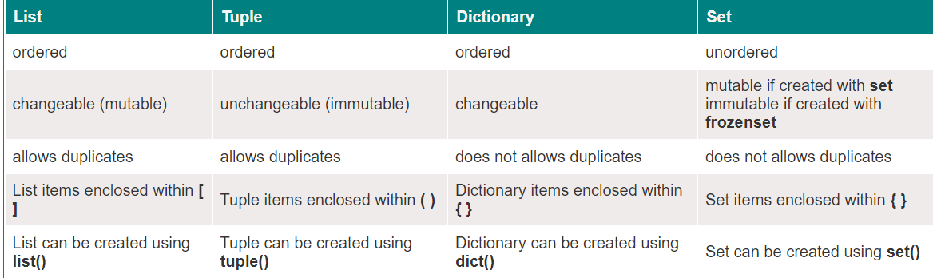
Comparison between List, tuples, dictionary & set
Keys

Slide 16
Knowledge Check (1 of 10)
Which of the following data structures is ordered and mutable?
a) Tuple
b) Dictionary
c) List
d) Set
Notes:
Key Message/s: Answer: Option C

Slide 17
Knowledge Check (2 of 10)
What will be the output of the following code?
a = (1, [2, 3], 4)
a[1].append(5)
print(a)
a) (1, [2, 3, 5], 4)
b) (1, [2, 3], 4)
c) Error: Tuple is immutable
d) None of the above
Notes:
Key Message/s: Answer: Option A

Slide 18
Knowledge Check (3 of 10)
What will be the output of the following code?
my_list = [1, 2, 3]
my_list.append(4)
print(my_list)
A) [1, 2, 3, 4]
B) (1, 2, 3, 4)
C) {1, 2, 3, 4}
D) [1, 2, 3]
Notes:
Key Message/s: Answer: Option A: [1, 2, 3, 4]

Slide 19
Knowledge Check (4 of 10)
What will be the output of the following code?
my_tuple = (1, 2, 3)
print(my_tuple[1])
A) 1
B) 2
C) 3
D) Error
Notes:
Key Message/s: Answer: Option B: 2

Slide 20
Knowledge Check (5 of 10)
Which of the following is a valid way to create a set in Python?
A) {1, 2, 3, 4}
B) set([1, 2, 3, 4])
C) set()
D) All of the above
Notes:
Key Message/s: Answer: Option D: All of the above

Slide 21
Knowledge Check (6 of 10)
What will be the output of the following dictionary operation?
my_dict = {"a": 1, "b": 2}
print(my_dict.get("c", 3))
A) None
B) 3
C) Error
D) {“a”: 1, “b”: 2, “c”: 3}
Notes:
Key Message/s: Answer: Option B: 3

Slide 22
Knowledge Check (7 of 10)
What will be the output of the following code?
list_1 = [1, 2, 3]
list_2 = list_1
list_2.append(4)
print(list_1)
A) [1, 2, 3]
B) [1, 2, 3, 4]
C) Error
D) [4, 1, 2, 3]
Notes:
Key Message/s: Answer: Option B: [1, 2, 3, 4]

Slide 23
Knowledge Check (8 of 10)
What will be the output of the following code?
my_set = {1, 2, 3, 4}
my_set.add(3)
print(len(my_set))
A) 3
B) 4
C) 5
D) Error
Notes:
Key Message/s: Answer: Option B: 4

Slide 24
Knowledge Check (9 of 10)
What will be the output of the following dictionary operation?
data = {"a": 1, "b": 2}
data.update({"b": 3, "c": 4})
print(data)
A) {"a": 1, "b": 2, "c": 4}
B) {"a": 1, "b": 3, "c": 4}
C) {"a": 1, "b": 2}
D) {"a": 1, "b": 3}
Notes:
Key Message/s: Answer: Option B: {"a": 1, "b": 3, "c": 4}

Slide 25
Knowledge Check (10 of 10)
What will be the output of the following tuple operation?
t1 = (1, 2, 3)
t2 = (4, 5)
t1 += t2
print(t1)
A) (1, 2, 3, 4, 5)
B) [1, 2, 3, 4, 5]
C) Error
D) (1, 2, 3, (4, 5))
Notes:
Key Message/s: Answer: Option A: (1, 2, 3, 4, 5)

Slide 26
Implement list, tuple, set and dictionary data types.
Understand difference between all complex data types

Slide 27
Thank You

